Slide 1

Portable Plant Monitor System
Group 4
Alexander Meade: CpE
Syed Bukhari: EE
Nicholas Poidomani: CpE
Kareem Rahounji: EE

Slide 2
Motivation
Create an environment to monitor plant growth and easily transport it
Provide researchers controlled environments to study plant life
Ability to move the environment without stress to the plant

Slide 3
Goals and Objectives
Primary Goals
Provide monitoring for plant growth
Make the environment portable
Switch between battery and AC power
Secondary Goals
Low power consumption
Exchangeable batteries
Low cost assembly

Slide 4
Specifications
Project Area | Design Specification
Temperature Monitoring | Be able to monitor temperatures from 20°C to 40°C
Humidity Monitoring | Be able to monitor up to 70% humidity
Battery Life | Run off battery for a minimum of 6 hours
Portability/Weight | Weight less than 20lbs
Portability/Size | Dimensions within 2ft x 2ft x 3ft dimension (LxWxH)

Slide 5
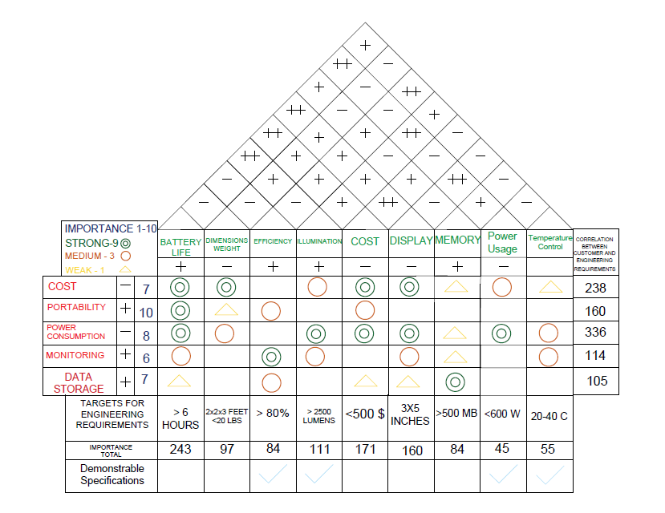
House
of
Quality

Slide 6
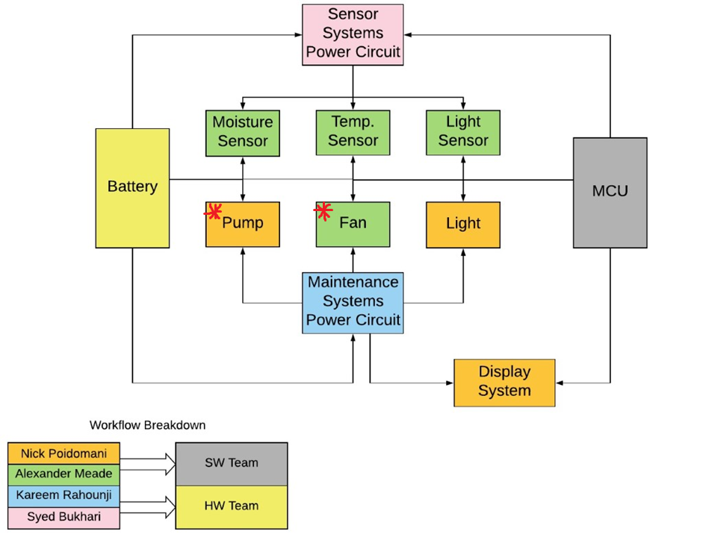
Block Diagram
* Means moved to stretch goal scope

Slide 7
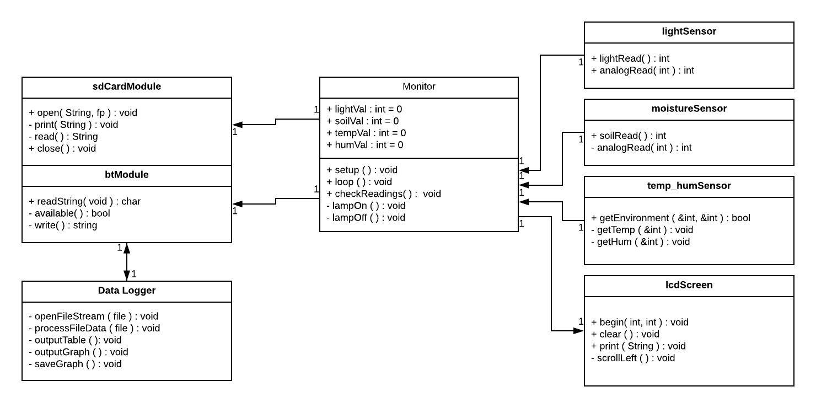
Class Diagram

Slide 8
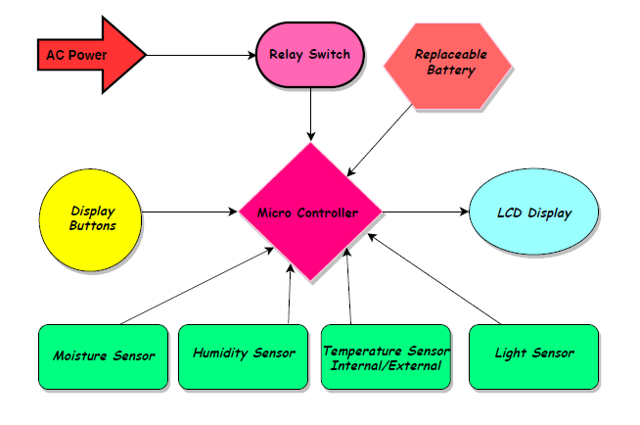
Electrical System

Slide 9
Project Design

Slide 10
Requirements for CPU
Need a CPU with ability to drive the sensors and communication
Still want to keep power consumption low
Desire for ease of integration of all parts
Potential to expand the scope of sensors used

Slide 11
CPU Comparisons
 | Atmega 2560 | PIC24FJ128GA010
Architecture | 8 Bit | 16 Bit
Program Memory | 256kB | 128kB
SRAM | 8kB | 8Kb
Clock Speed | 16MHz | 32MHz
EEPROM | 4kB | 64kB
Number of Timers | 6 | 5
JTAG Support | Yes | No
GPIOs | 86 | 100

Slide 12
MCU Decision
Choice - Atmega 2560
Reasons:
Ease of flashing code into the MCU
Better integration into our PCB due to documentation
Tradeoffs:
Lose of some modules
More limited CPU resources
Limited file handling

Slide 13
Potential Environment Sensors
Many sensor options but we want the most relevant to growth
Soil Moisture
Humidity
Temperature
Light Level
Soil Nutrient
Accelerometer

Slide 14
Sensor Type Selection
Soil Moisture
Dry soil can cause malnutrition
Light
Light is critical to all plant life
Temperature and Humidity
Extreme conditions can be damaging to plant growth

Slide 15
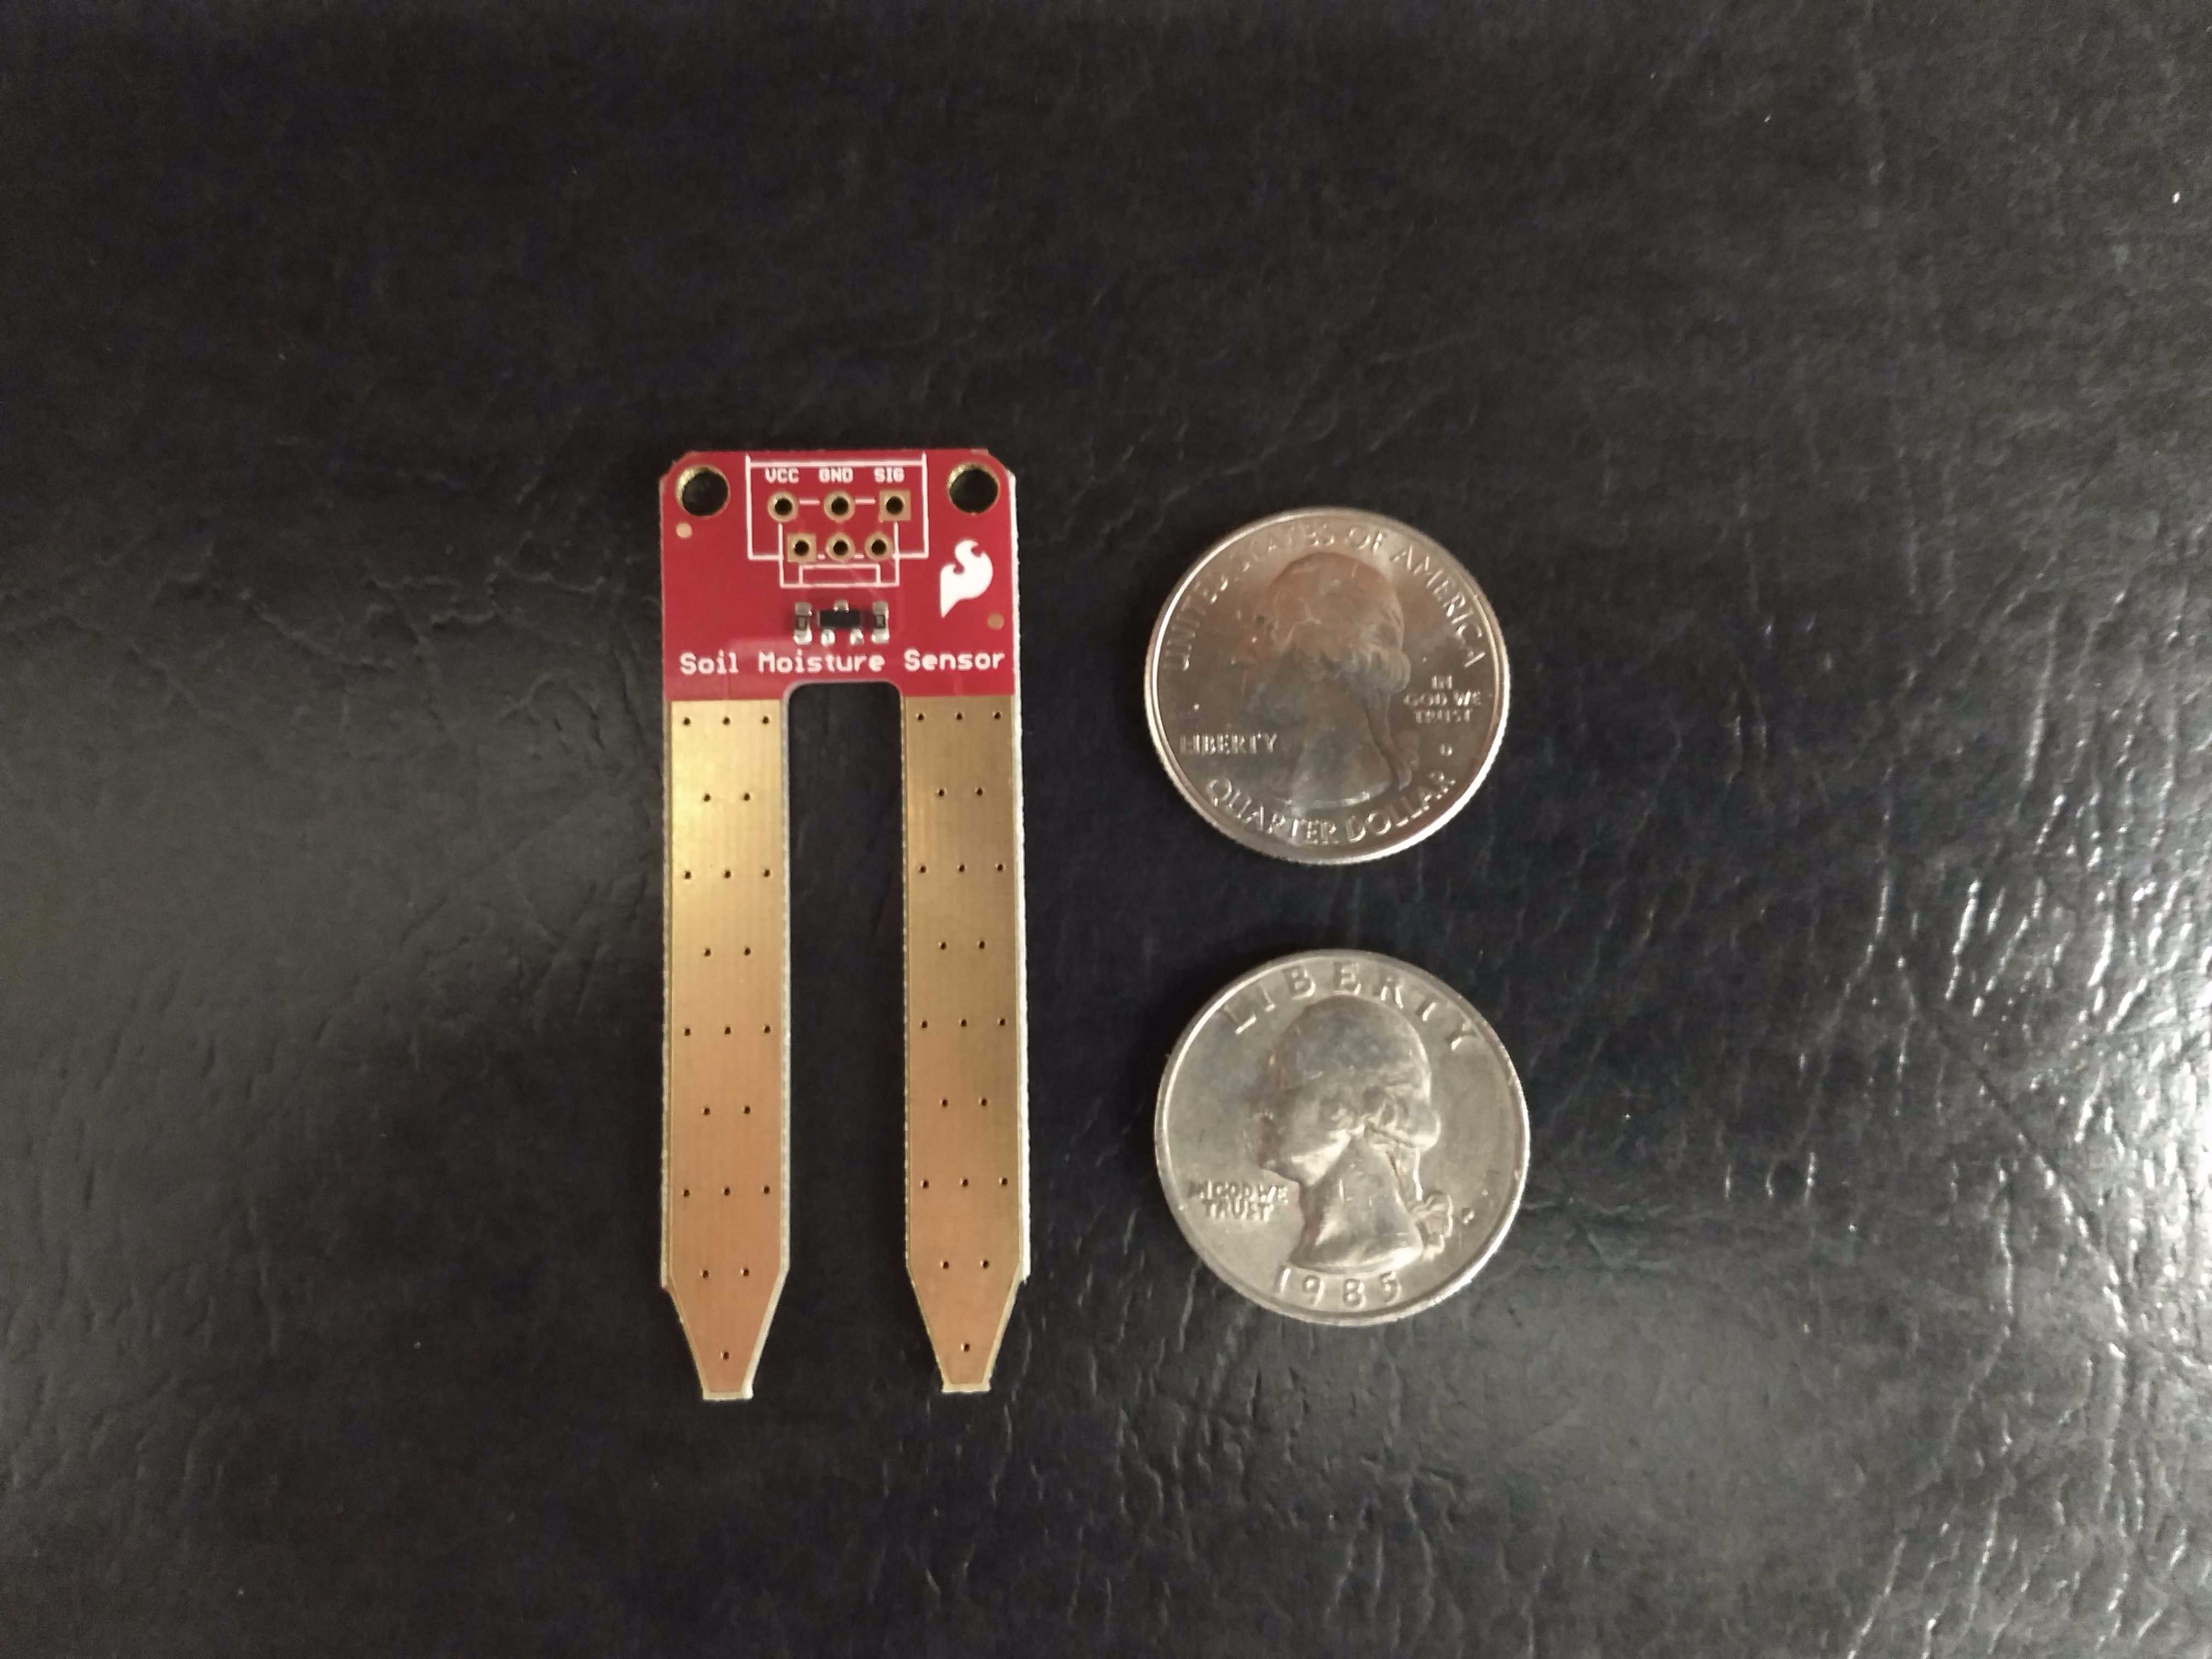
Soil Moisture Sensor SEN-13322
Low cost
High accuracy
Simple interfacing

Slide 16
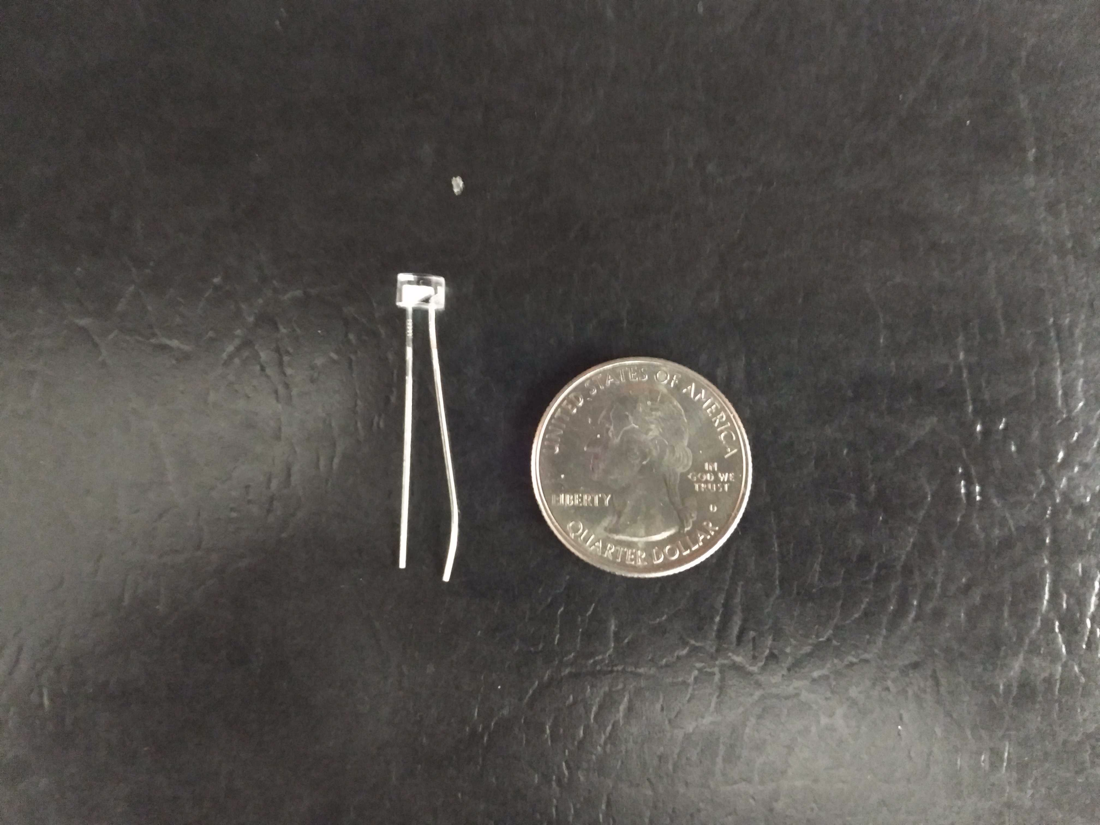
Everlight Sensor EAALST05RDMA0
Low cost photoelectric diode compared ambient light counterparts
Threshold levels allow distinction between low and optimal light levels

Slide 17
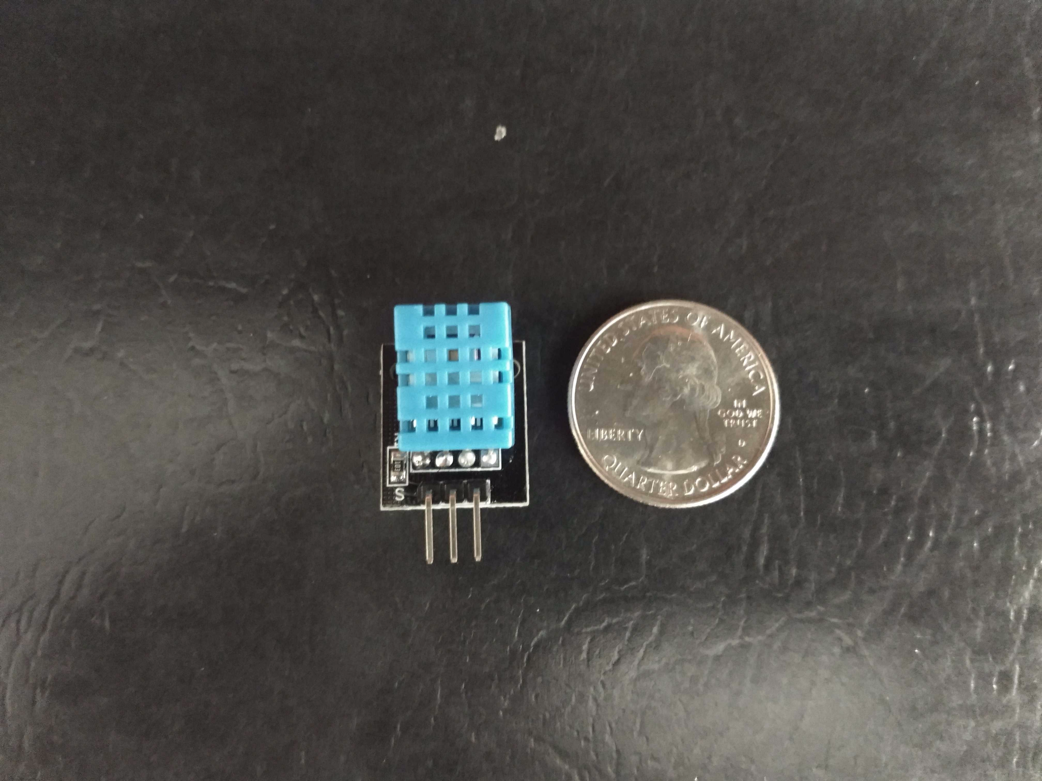
Temp and Humidity DHT11
Ultralow cost sensor reads temperature and humidity
Functions wide range of temperatures
Sampling rate of 1HZ
Low power use

Slide 18
Wireless Technology Comparison
 | Wi-Fi | Zig-Bee | Bluetooth | GSM
Range | Up to 100m | 10m-100m | <100m | Ranges from over 100m to 35km
Cost | ~ $10-$30 | ~ $15-$20 | ~$10-$20 | Most Expensive ~ $150
Power Consumption | High Power Draw | Lowest Power Draw | Low Power Draw | Highest Power Draw
Data Transfer | Up to 55Mbps | 20-250Kbps | 1-3Mbps | 40-50Kbps

Slide 19
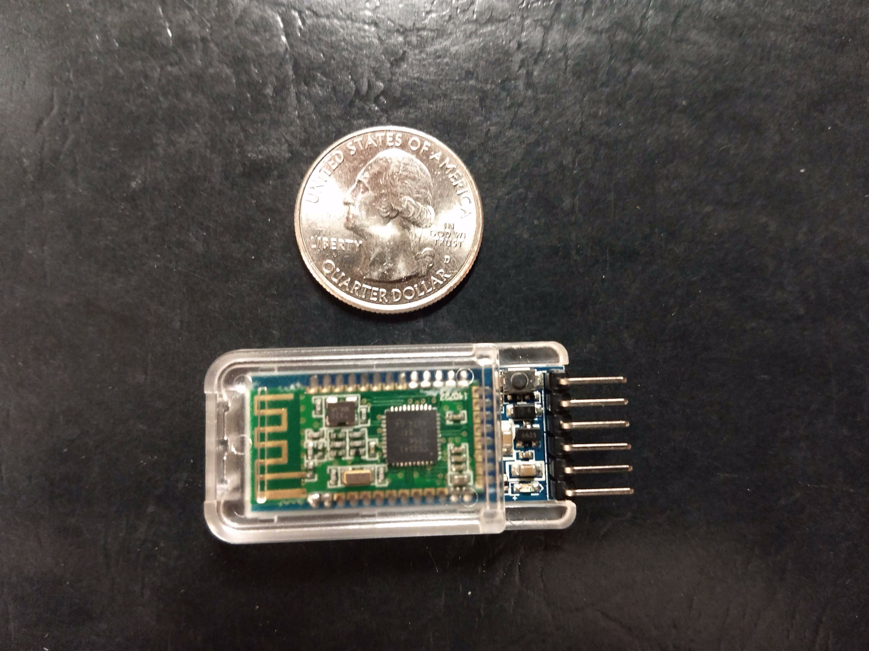
Wireless Module Choice
SH-HC-08
Transportation protocol chosen was Bluetooth Low Energy
BLE moderate transfer rate, good broadcast distance, and very low energy consumption
SH-HC-08 utilizes UART for communication

Slide 20
Data Storage
We want the ability to store data locally in case communications are down
Challenged faced is ballooning data size from readings
Solutions options considered EEPROM, NAND flash memory, and external SD card slot

Slide 21
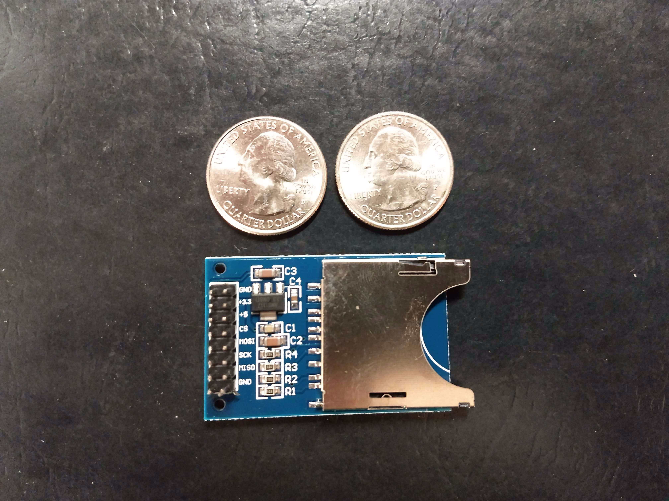
Implementation SD Slot
Allows for large storage space for sensors readings
Ease of integration into the existing design
Allows for access of data in case of total PCB failure

Slide 22
Supporting Software
Identify trends that correlate plant growth with environment readings
Organize our data into graphical representations
Ability to identify inconsistencies in the environment
Prefer cross platform tools

Slide 23
Project Implementation

Slide 24
DC Power Supply
Keep the PCB running under all conditions
Is powered by an AC to DC adapter
Operational voltage range 5V-12V
Need a method to continue use after disconnecting from AC

Slide 25
Battery Back-up Circuit
9V battery is the back-up power supply
Allows the circuit to keep running after it is unplugged
Battery take-over features:
Automated switching
Easy battery replacement
Portability
Long running times

Slide 26
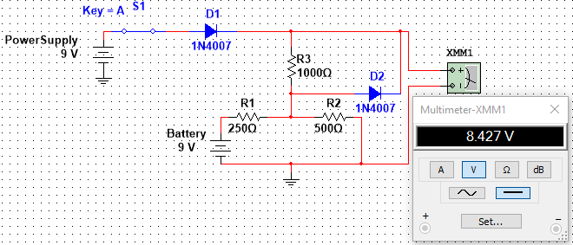
Closed Switch (Power Supply)

Slide 27
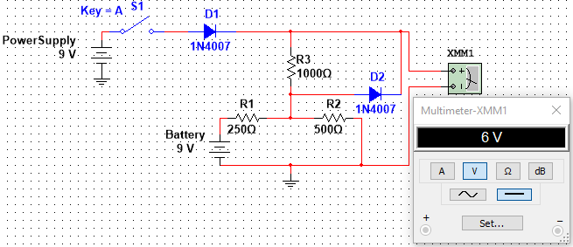
Open Switch (Battery Backup)

Slide 28
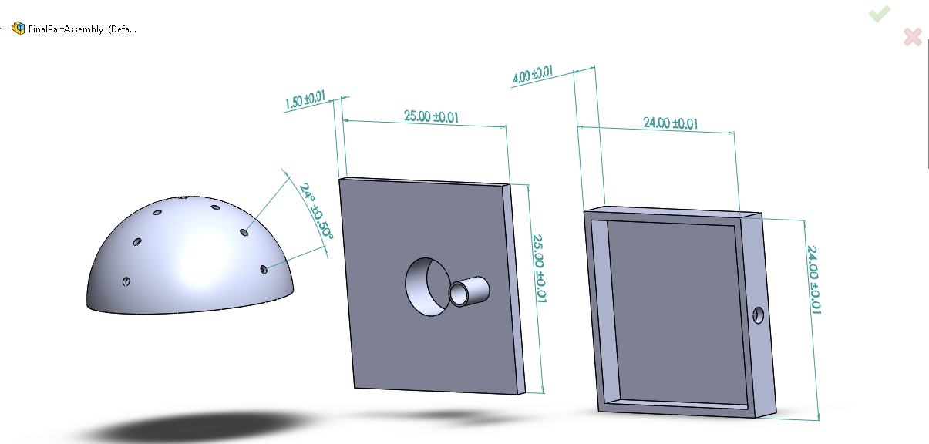
Enclosure Design

Slide 29
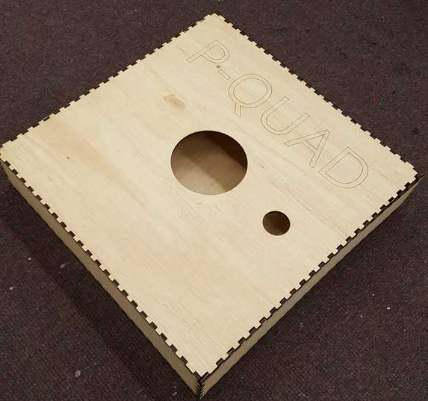
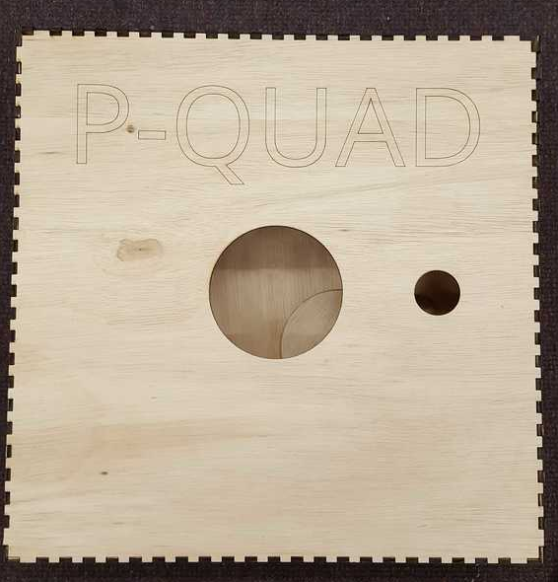
Enclosure

Slide 30
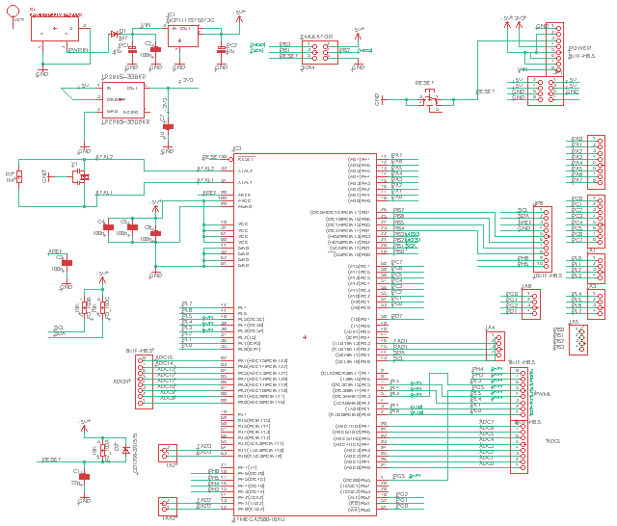
PCB Schematics

Slide 31
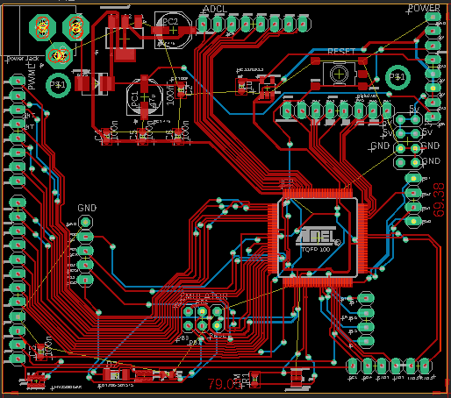
Full PCB

Slide 32
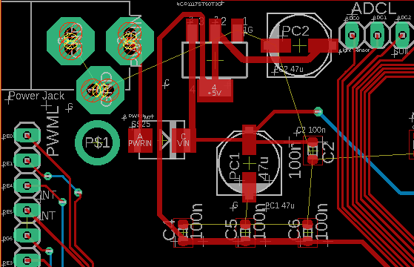
PCB Power Section

Slide 33
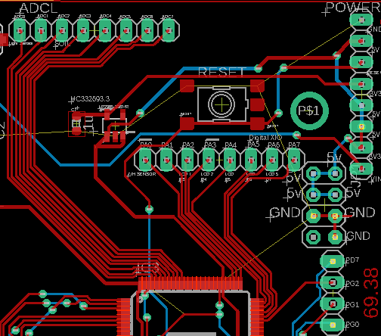
PCB Reset & Stepdown

Slide 34
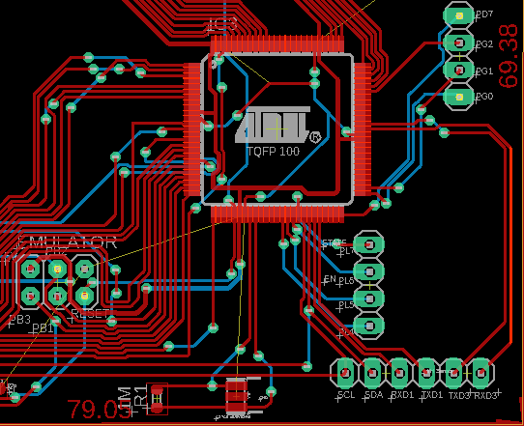
PCB MCU, EMU, and Resonator

Slide 35
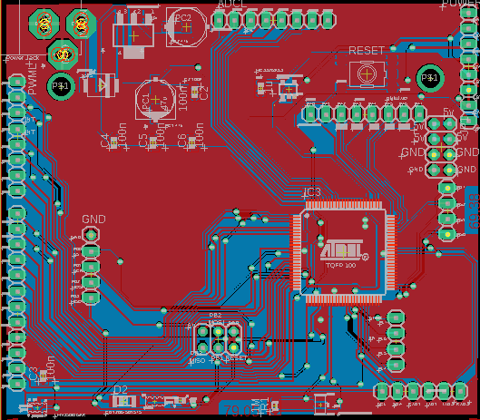
PCB Grounded Top Layer

Slide 36
Administrative Content

Slide 37
Work Distribution
Name/Section | Kareem | Nick | Alec | Syed
Sensor Programming |  | Secondary | Primary
Wireless Communication |  | Primary | Secondary
PCB Design | Secondary |  |  | Primary
Power | Primary |  |  | Secondary
Data Logger |  | Secondary | Primary
Enclosure Design | Primary |  | Secondary

Slide 39
IEC 60529 Standard
Degrees of protection against water ingress
Protection level at minimum is 2 (Protected against vertically falling water drops when enclosure tilted up to 15°) with a maximum level of 4 (Protected against splashing water )
Degrees of access to hazardous Parts
The level of protection provided for hazardous part protection is a 2, protection of hazardous parts from a finger or a solid foreign objects ≤ 12.5 mm diameter

Slide 40
Project Projected Budget
Expense | Estimated | Actual | Difference ($) | Difference (%)
PCB | $ 50.00 | $ 40.00 | $ 10.00 | 20%
CPU | $ 25.00 | $ 10.00 | $ 15.00 | 60%
Moisture Sensor | $ 80.00 | $ 15.00 | $ 65.00 | 81%
Light Sensor | $ 30.00 | $ 8.00 | $ 22.00 | 73%
Temp/Hum Sensor | $ 30.00 | $ 33.00 | $ (3.00) | -10%
Light Source | $ 40.00 | $ 15.50 | $ 24.50 | 61%
LCD Display | $ 30.00 | $ 20.00 | $ 10.00 | 33%
Enclosure | $ 70.00 | $ 35.00 | $ 35.00) | 50%
Dev Kits | $ 40.00 | $ 34.00 | $ 6.00 | 15%
Batteries | $ 20.00 | $ 14.00 | $ 6.00 | 30%
SS Relay | $ 10.00 | $ 6.00 | $ 4.00 | 40%
Bluetooth Module | $ 20.00 | $ 8.75 | $ 11.25 | 56%
SD Mount | $ 15.00 | $ 9.00 | $ 6.00 | 40%
Unplanned Parts | N.A | $ 45.00 | $ (45.00)
Extra |  |  | $ -
Total Expenses | $ 460.00 | $ 293.25 | $ 166.75 | 36.25%

Slide 41
Bill of Material as of 1/22/19
Quantity | Part | Unit Price | Line Total | Quantity | Part | Unit Price | Line Total
2 | 2.1mm Barrel Jack | 1.625 | 3.25 | 2 | 16MHz Resonator | 0.315 | 0.63
2 | 47uF Cap | 1.255 | 2.51 | 2 | 47uF Cap | 1.435 | 2.87
1 | 1A Schottky Diode | 0.31 | 0.31 | 3 | LDO Regulator | 0.4967 | 1.49
1 | 2A Schottky Diode | 0.43 | 0.43 | 10 | 1A Switching Diode | 0.076 | 0.76
3 | 1uF Cap | 0.25 | 0.75 | 1 | MCU ATMEGA2560 | 10.65 | 10.65
10 | .1uF Cap | 0.005 | 0.05 | 1 | SD Card Slot | 6.59 | 6.59
10 | 1uF Cap | 0.105 | 1.05 | 1 | Bluetooth Module | 7.99 | 7.99
4 | LDO Regulator | 0.4025 | 1.61 | 1 | DHT11 Sensor | 5 | 5
10 | 150mA Switch Diode | 0.125 | 0.5 | 1 | SEN-13322 | 5.95 | 5.95
10 | Res Film Array 10k | 0.014 | 0.14 | 1 | EAALST05RDMA0 | 0.6 | 0.6
4 | 1A Schottky Diode | 0.3925 | 1.57 |  | Total | 44.4017 | 55.47
2 | 16MHz Resonator | 0.385 | 0.77

Slide 42
Issues
PIC24 VS Atmega2560 for PCB
Originally enclosure was going to be 3-D printed but due to fabrication constraints we have to switch to underlayment wood
Deciding which goals fit with our projects paradigms and which had to be pushed to stretch goals
Integration of humidity and temperature readings for accurate timing and integration into system

Slide 43
To Complete
Fabricate the environmental enclosure
Write MCU logic for SD card slot and Bluetooth
Application interface for accessing of data

Slide 44
Questions?

